Slide 1
Smart trash cans for a smarter world, starting at UCLA.
IDEA Hacks Team 7

Slide 2
Why Bruin Bins?

Slide 3
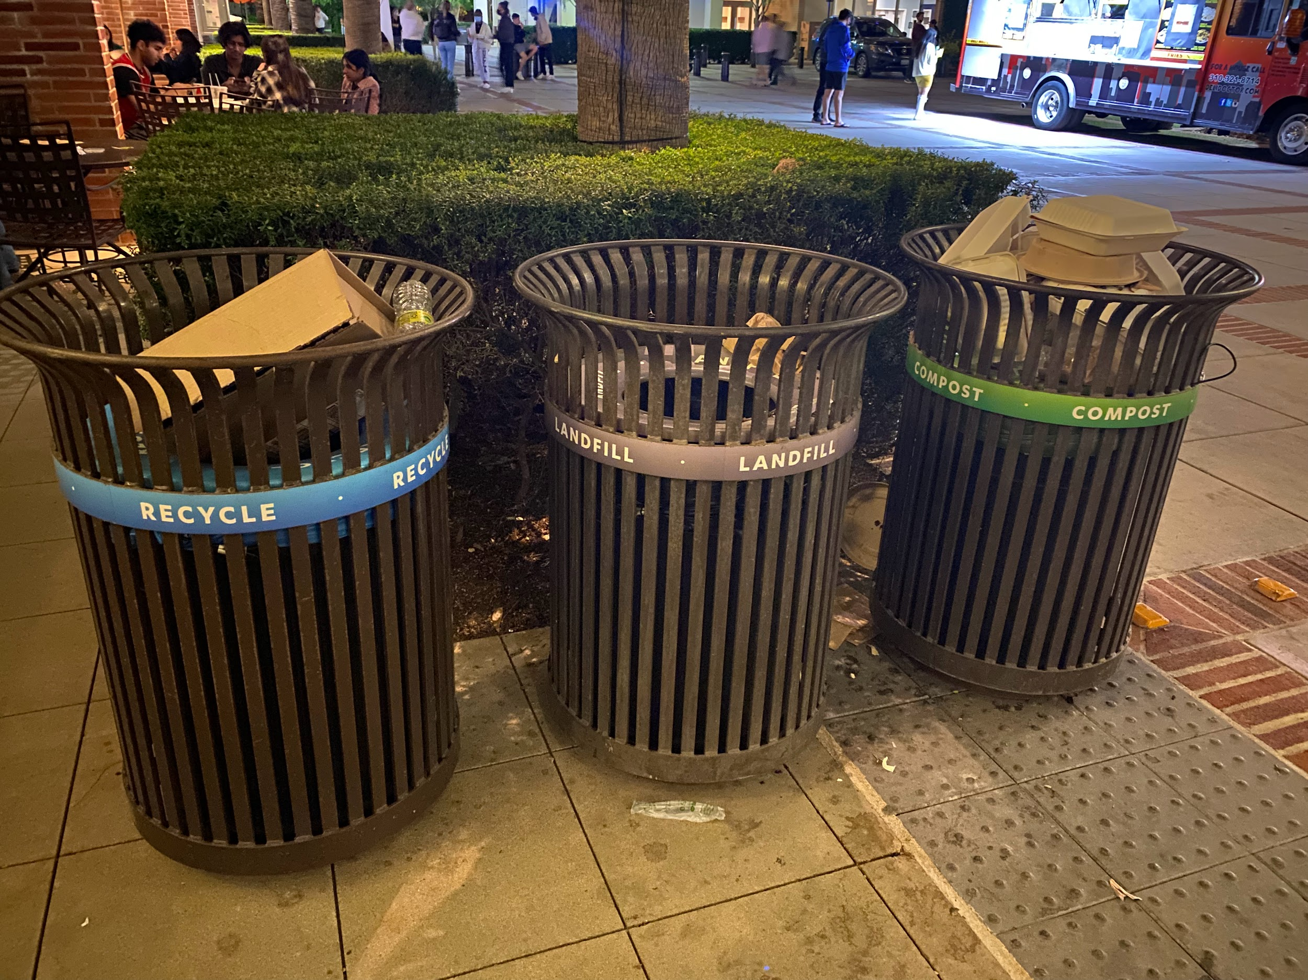
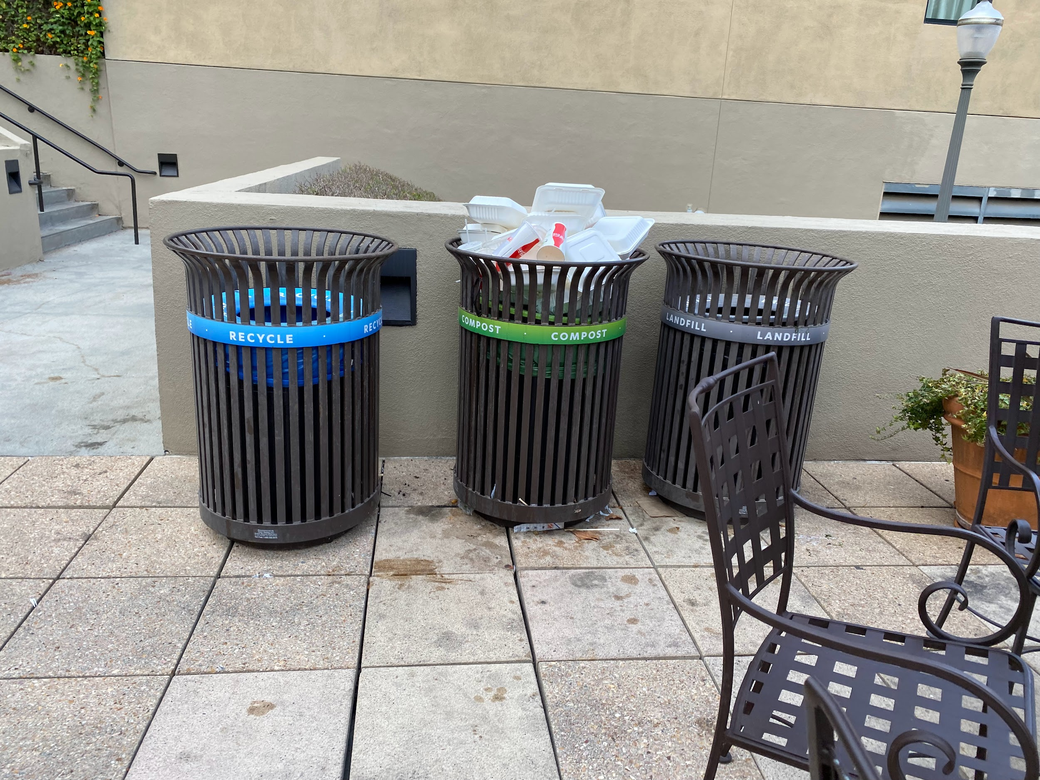
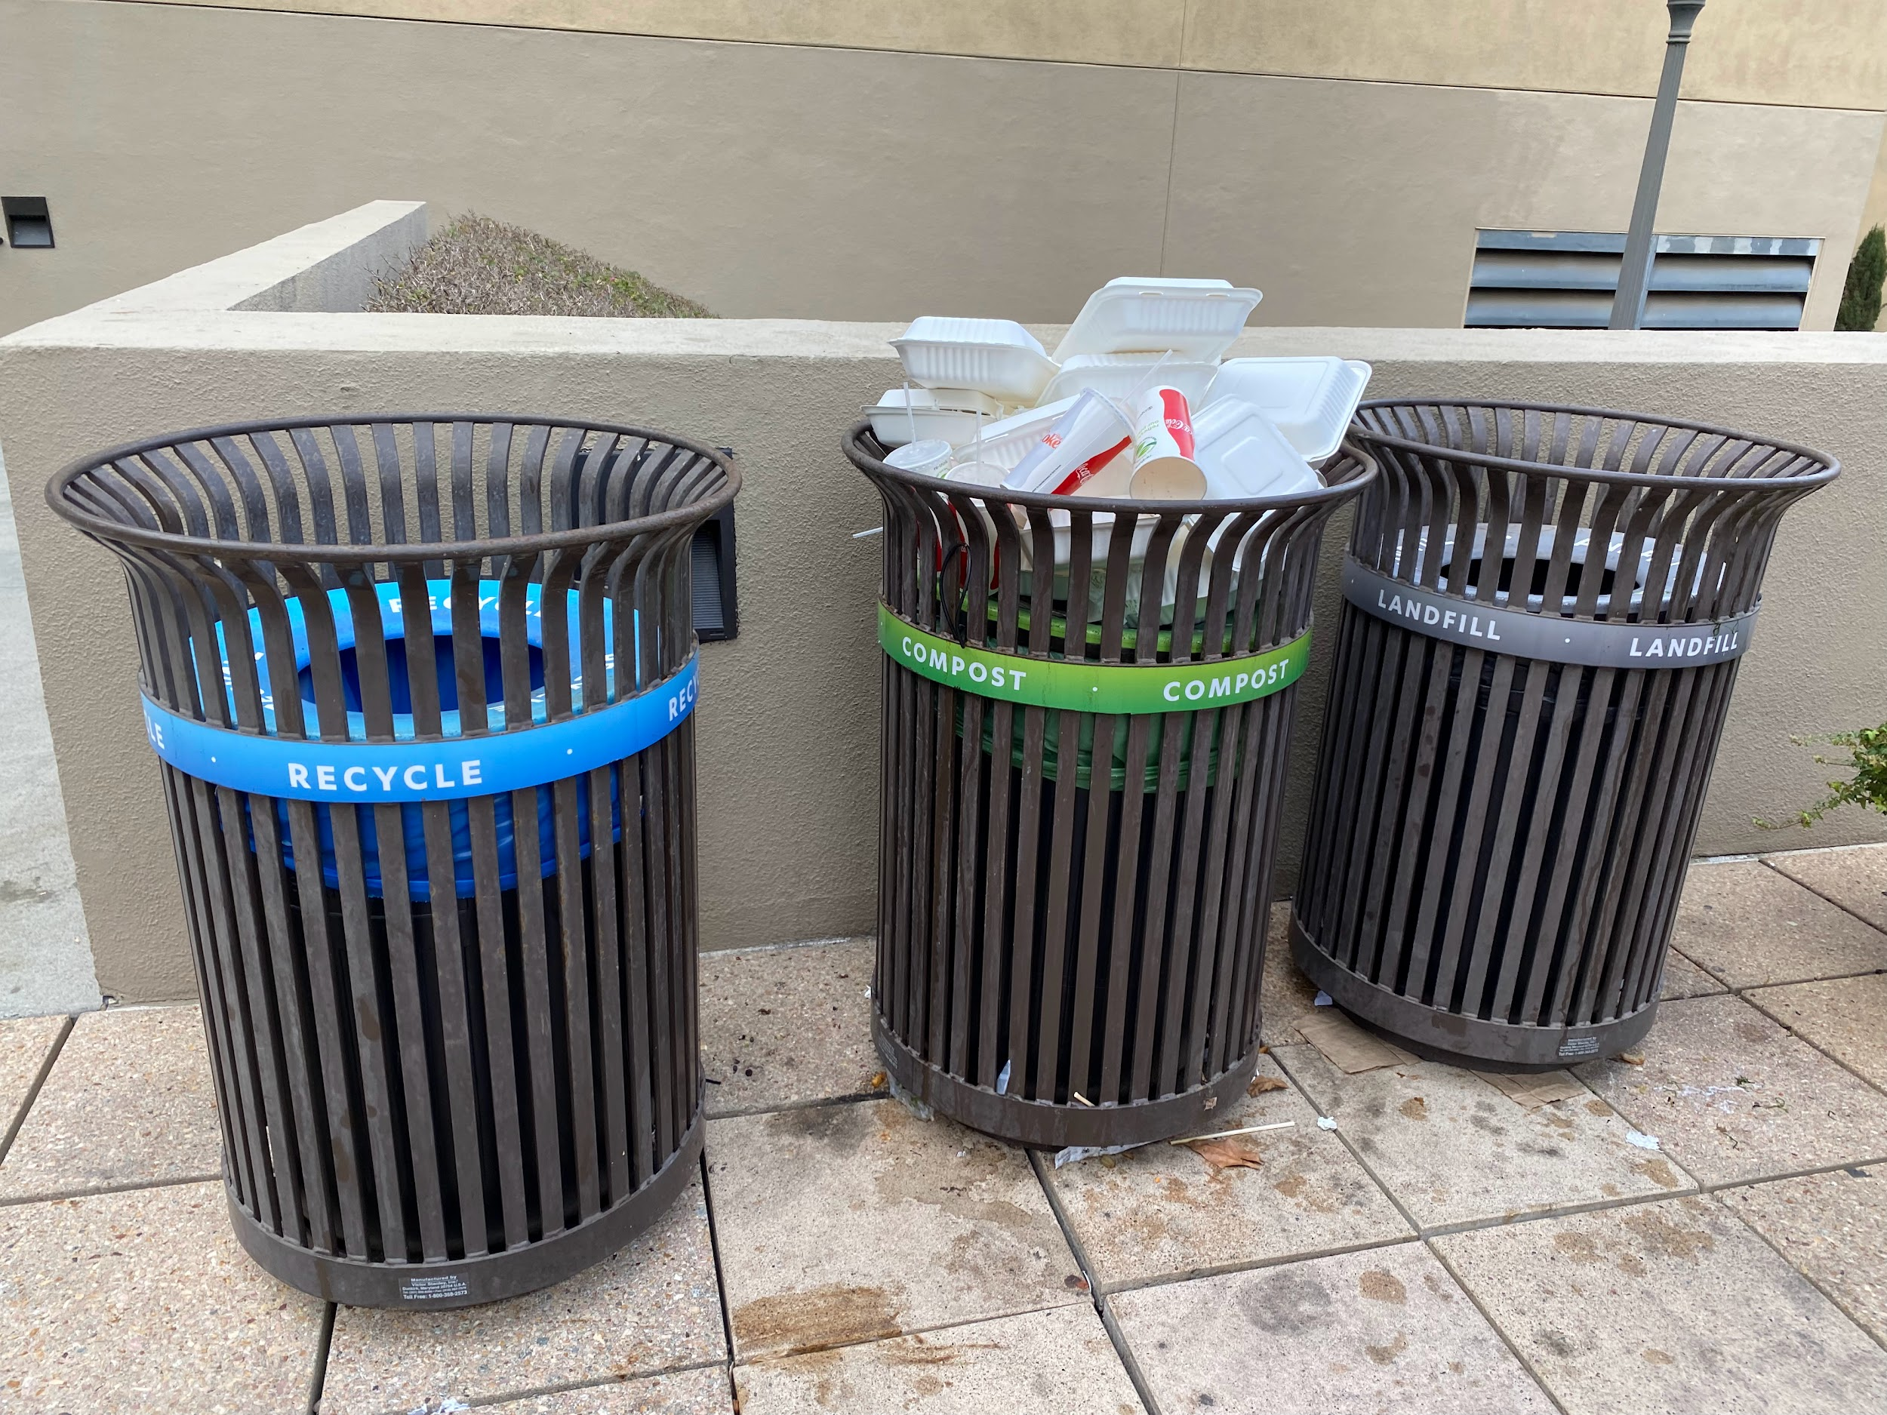
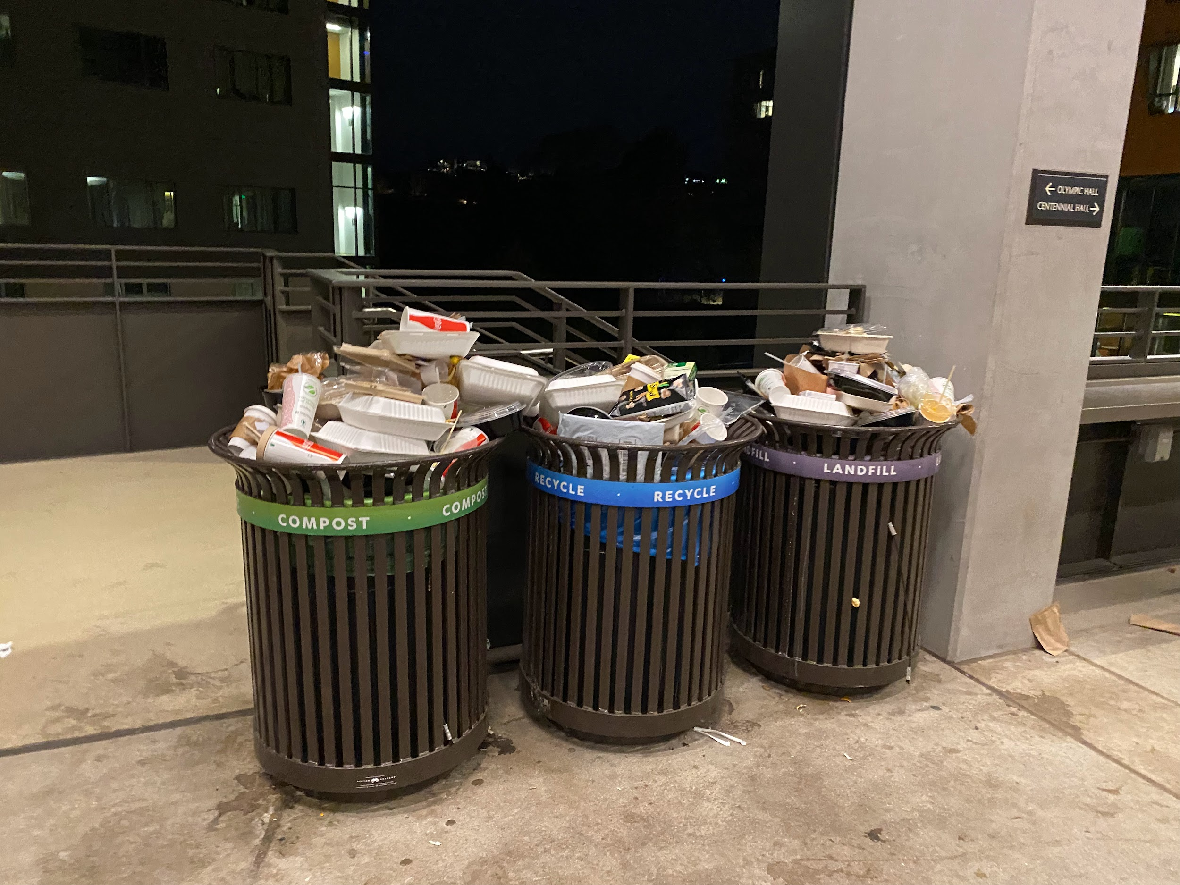
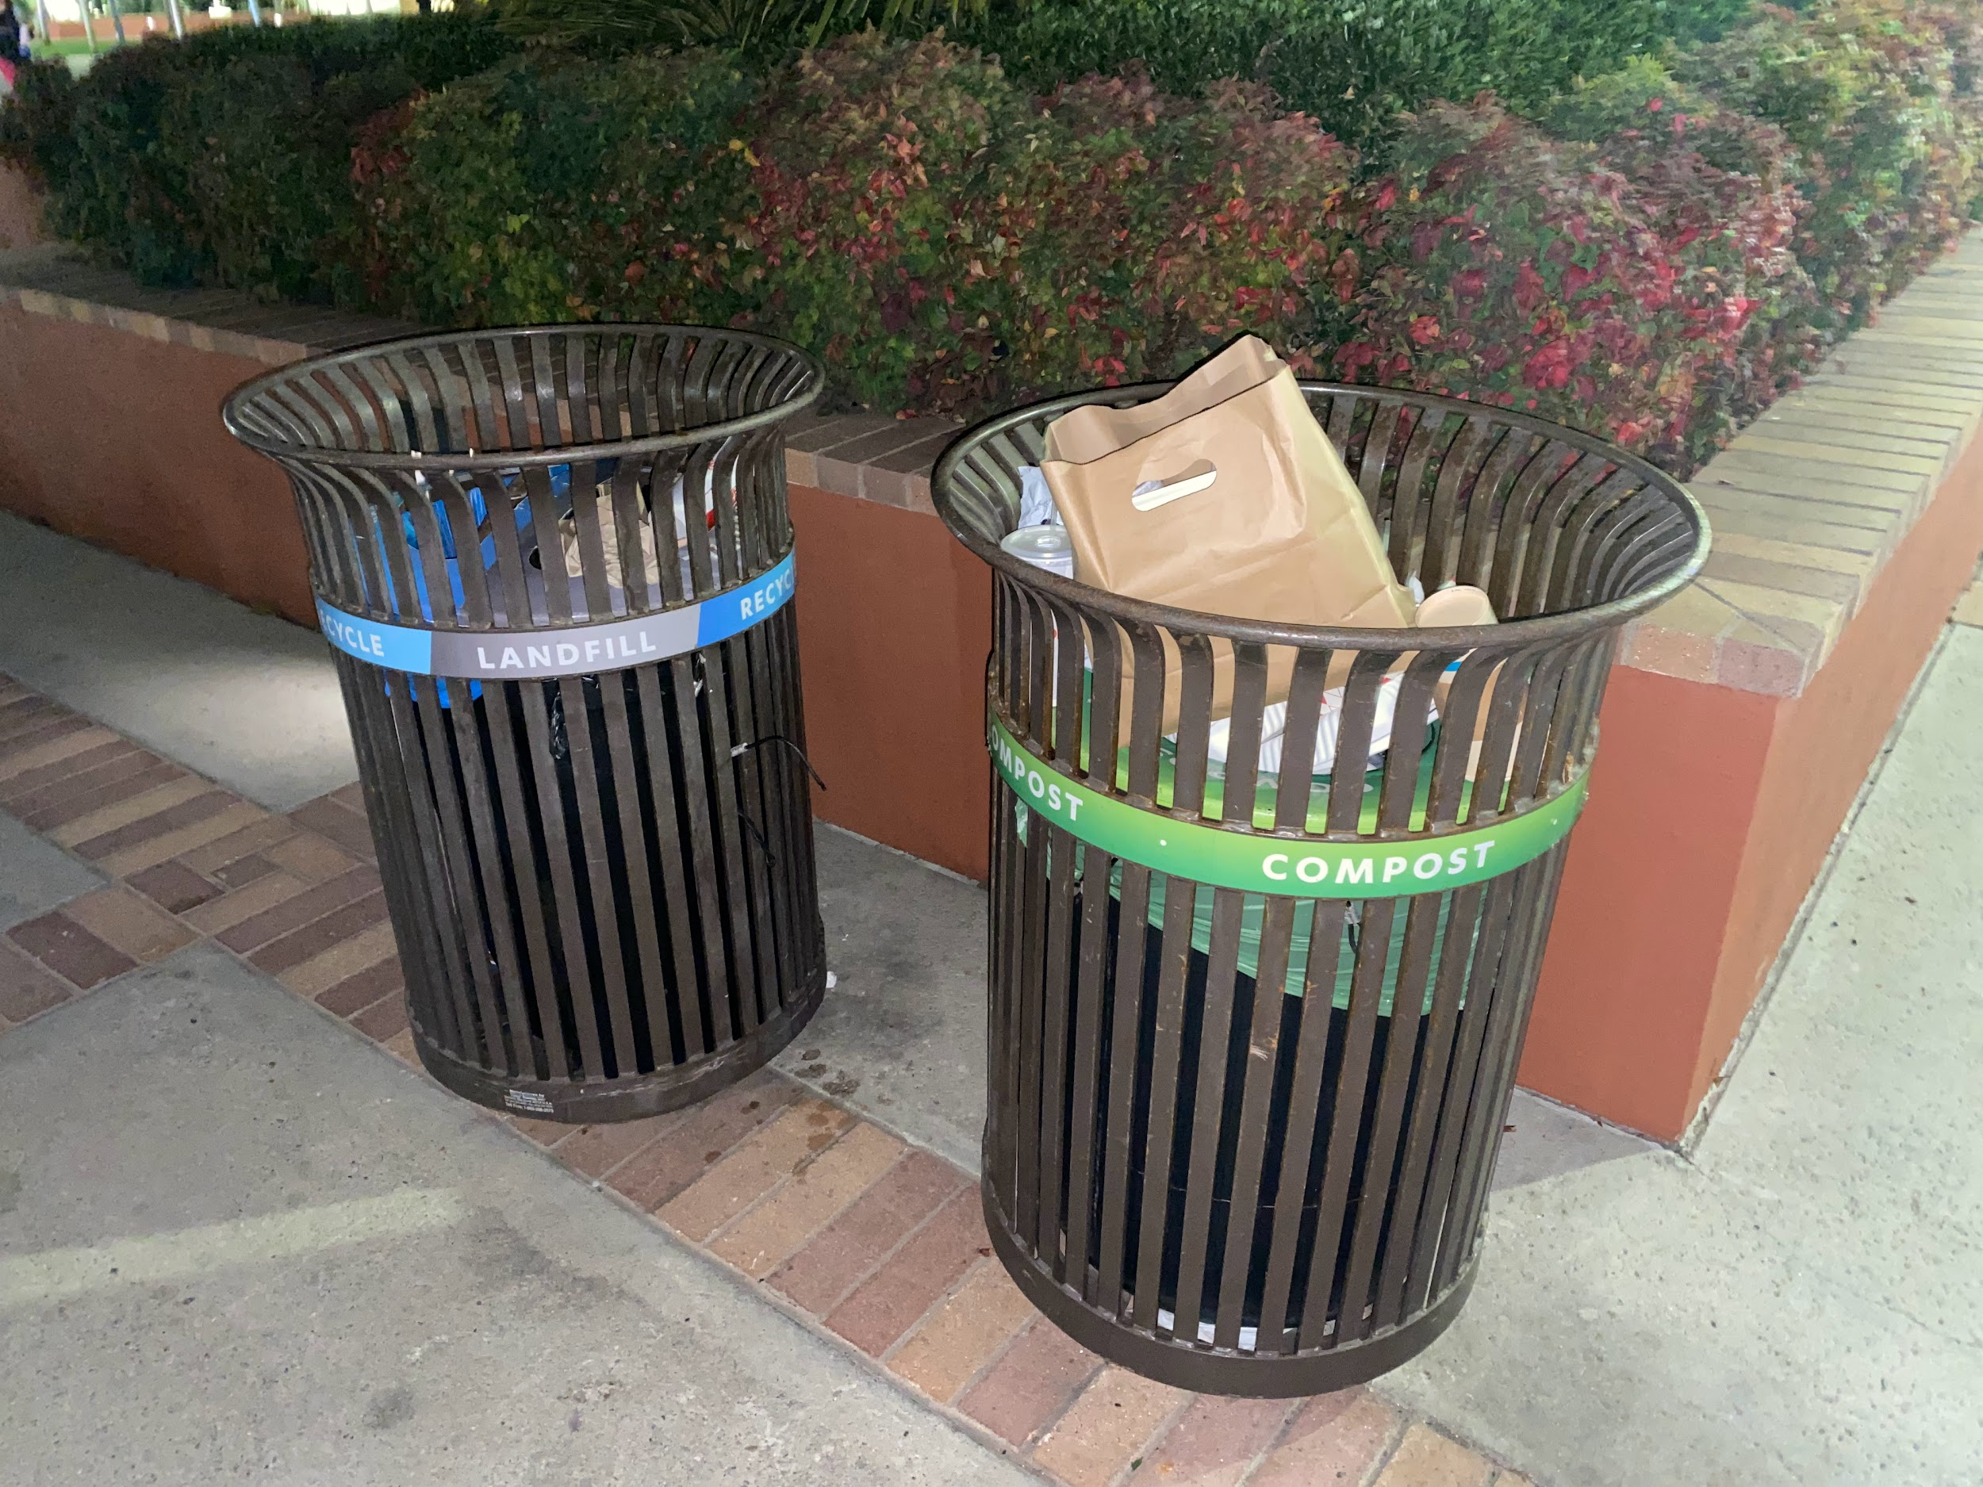
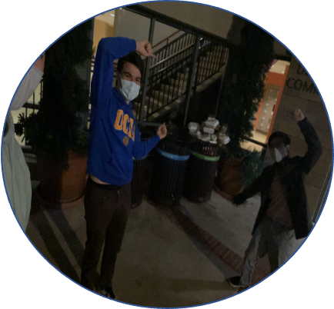
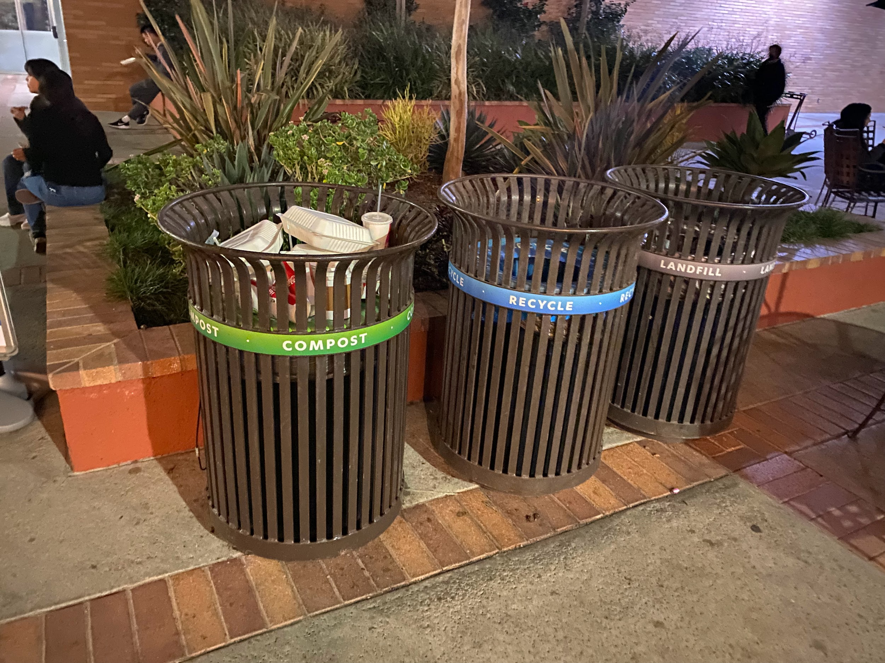
UCLA has a trash problem.
Reducing quality of life
Non-proper trash disposal
Some trash cans are overused, while some are underutilized
Stalling UCLA’s 2025 zero-waste target
Notes:
UCLA zero-waste Policy Target: 90% diversion from landfill by 2025
When trash goes in the wrong trash can, compost could go to landfill as well as contaminate recyclable trash

Slide 4
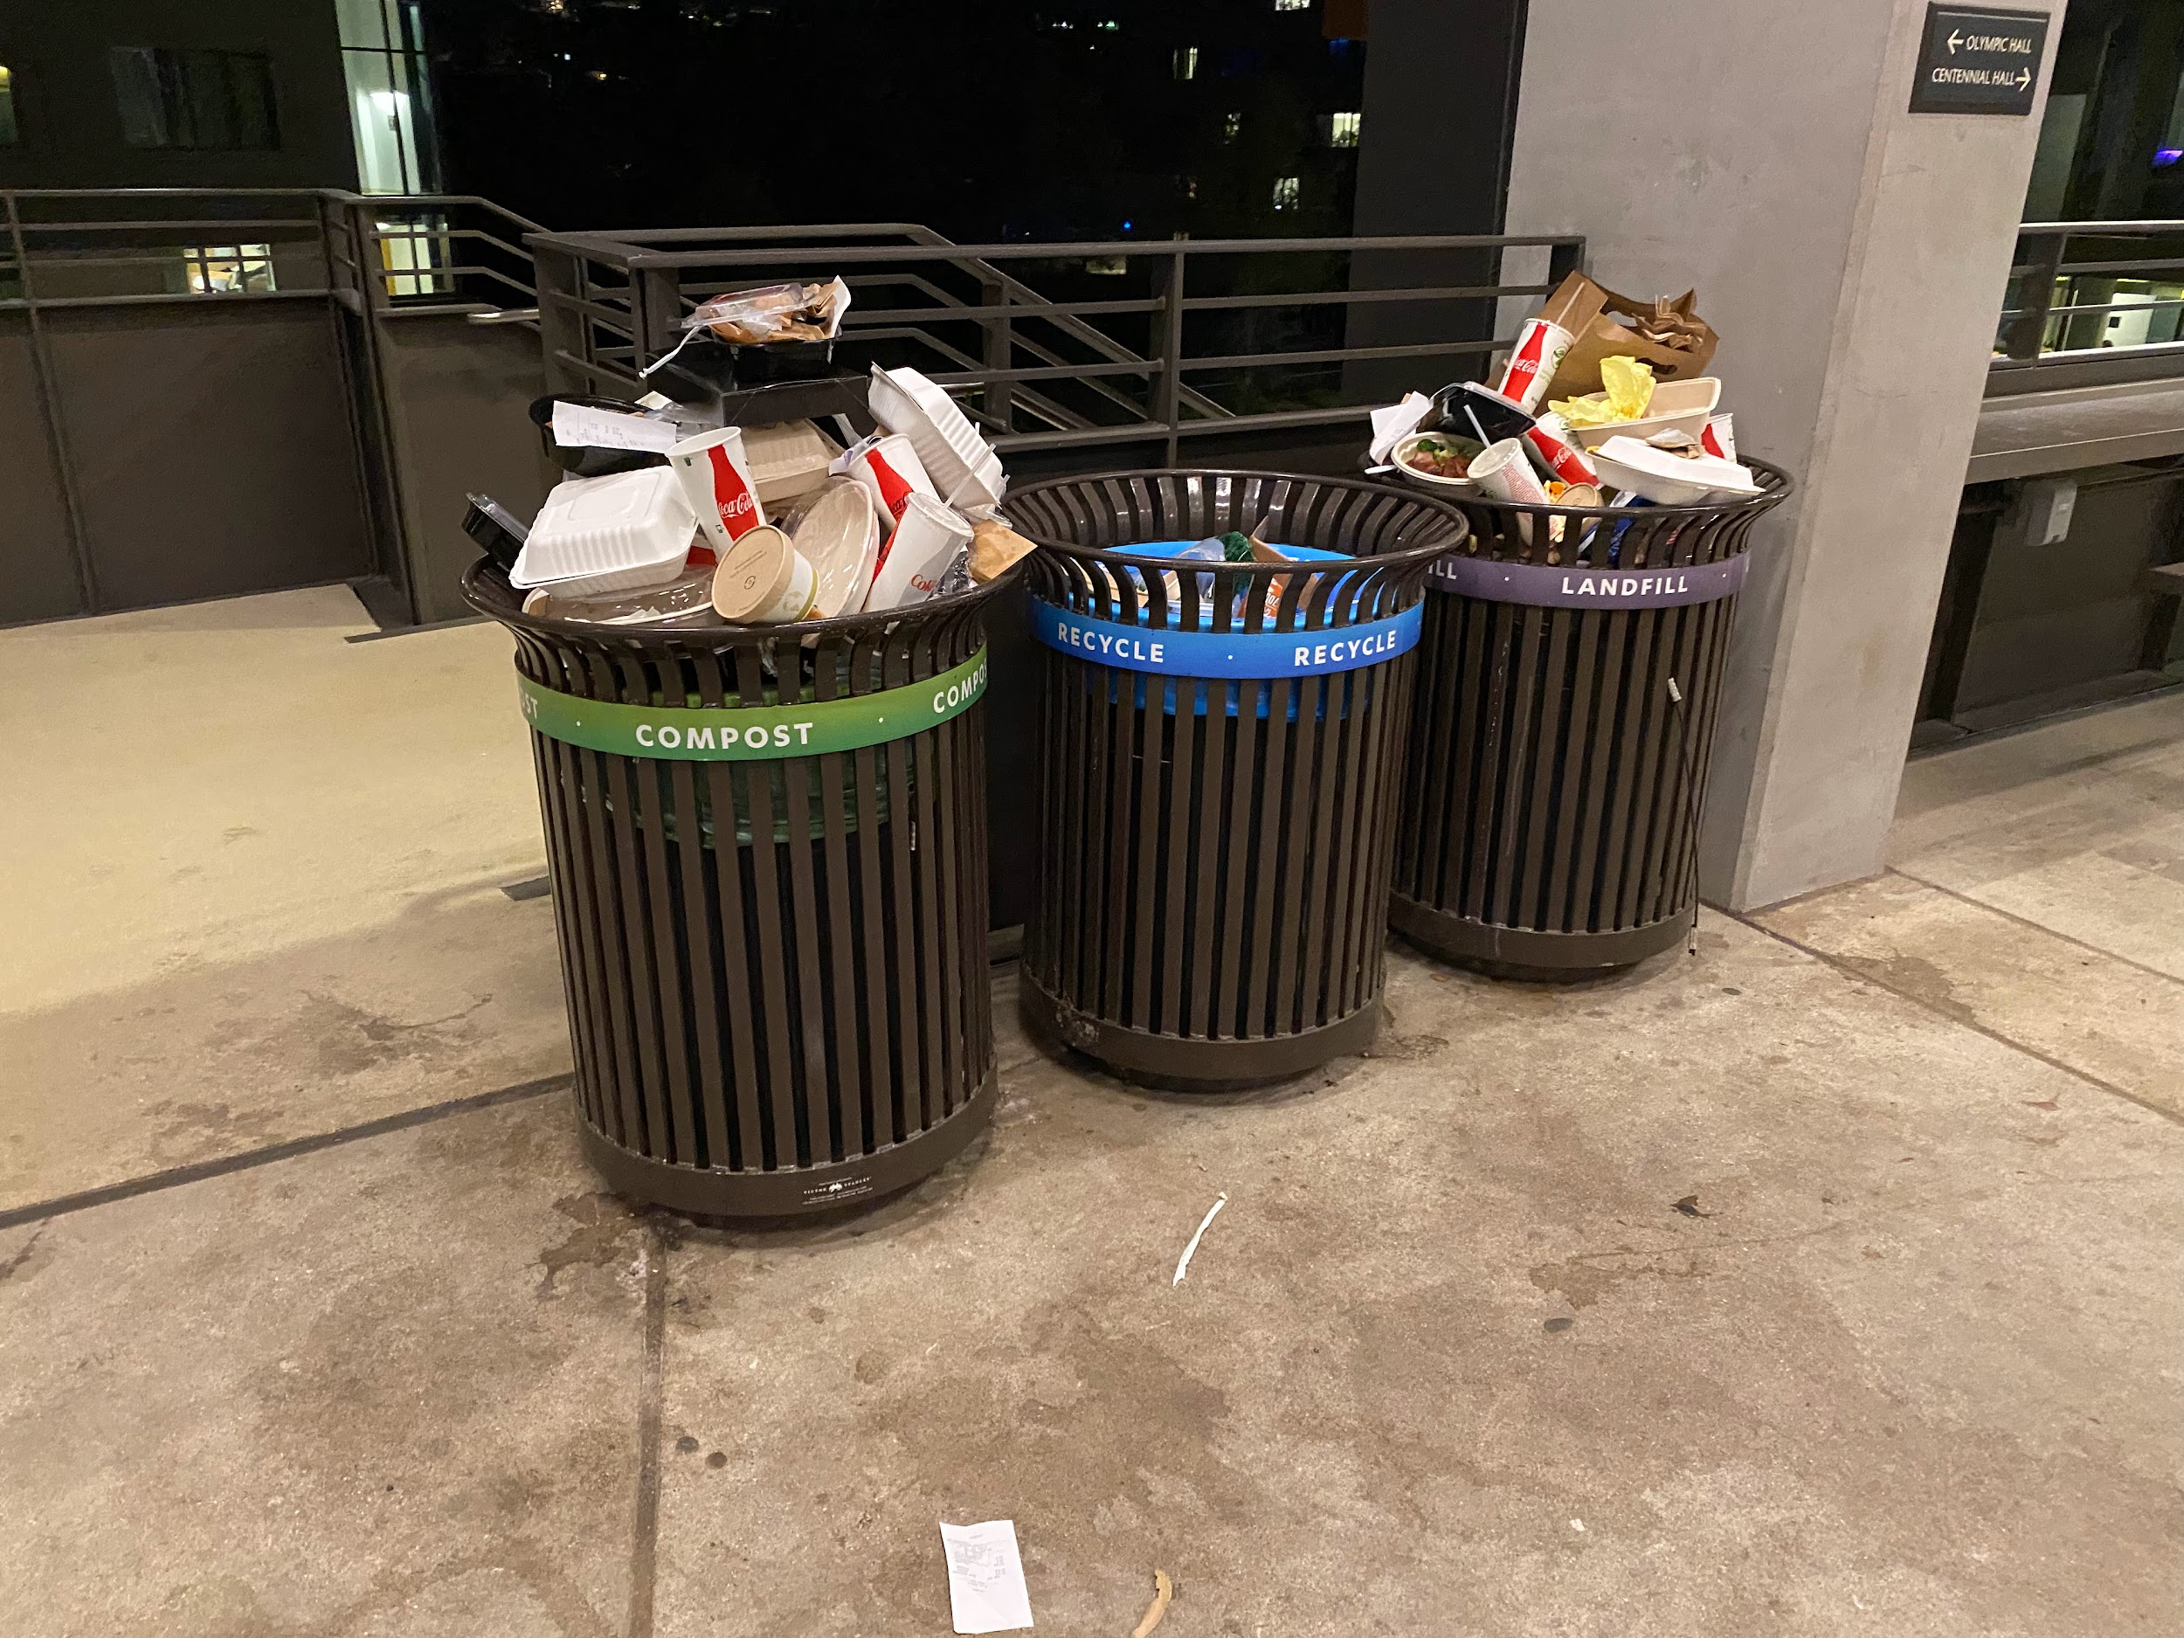
Overused Trash Cans (incorrect uses too!)
Underused Trash Cans

Slide 5
What do Bruin Bins do?

Slide 6
Bruin Bin Capabilities
01.
02.
03.
Detect Trash Level
Display Percentage
Lock the Bin
04.
05.
06.
Map Display
Notify the Admin
Data Visualization
Using weight and distance sensors
Showing percentage fullness on an oled screen
Prevent trash from overflowing
Guide students to a suitable bin
Improve the logistics of emptying trash cans
Detect where most trash is to optimize trash can type and location.

Slide 7
How do Bruin Bins Work?
Technical Details

Slide 8
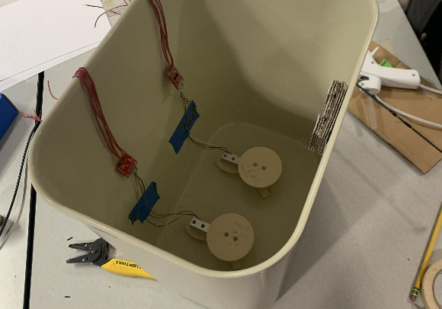
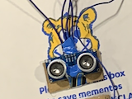
Hardware Feature #1: Trash Weight / Volume Sensing
Data is collected using two load cells and and a sonar sensor (connected to ESP32 microcontroller)
Distance sensor
(located on the lid of the trash can pointing downwards)
Load cells (weight sensors)

Slide 9
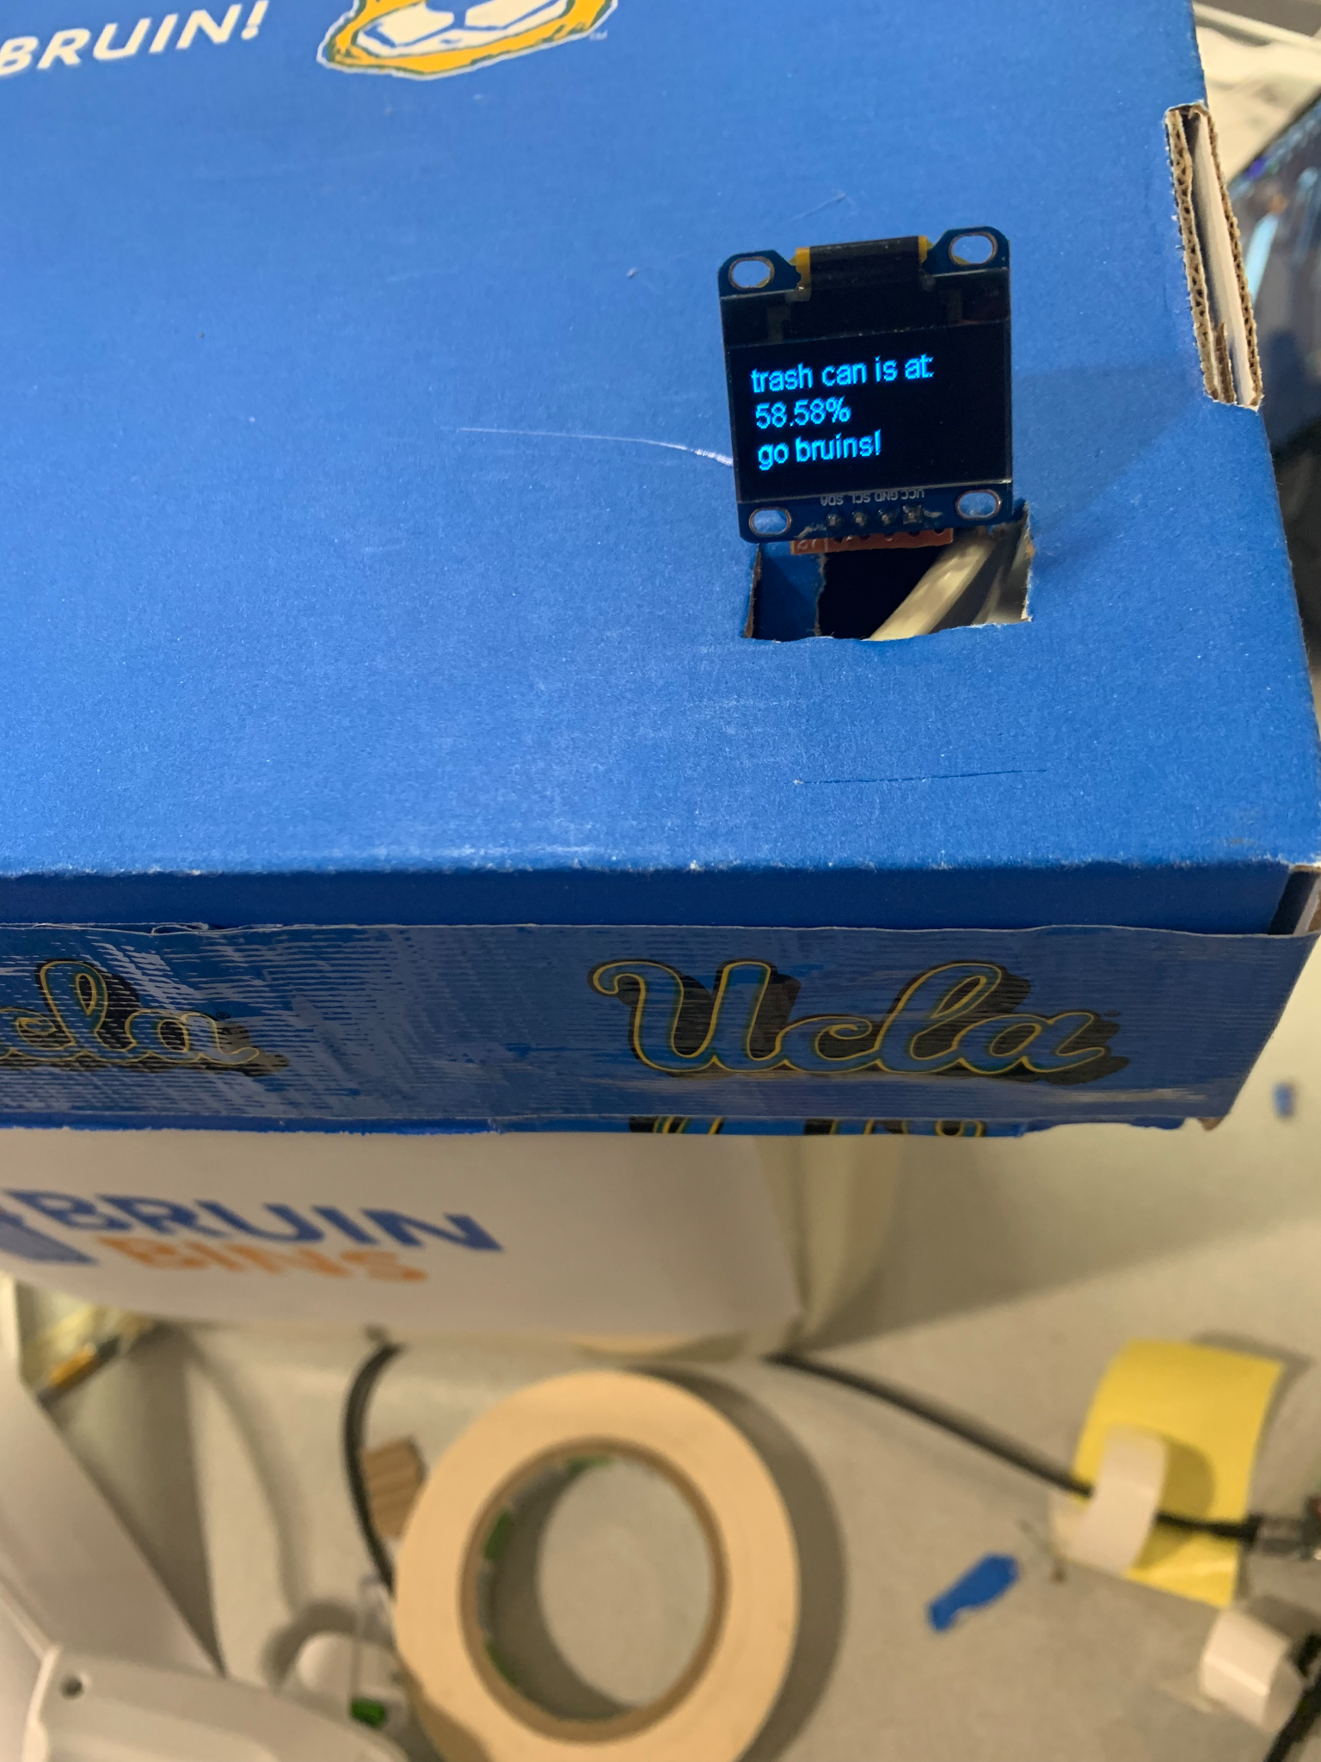
Hardware Feature #2: Displaying Fullness of Trash can
Oled panel (located on top of trash can lid), (connected to ESP32 microcontroller)

Slide 10
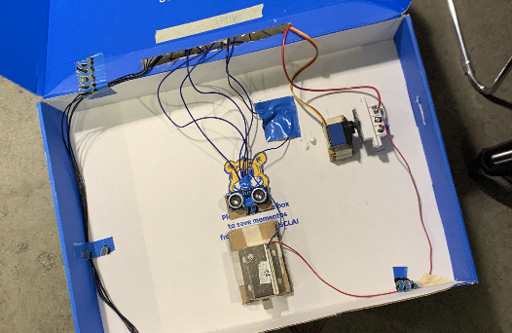
Hardware Feature #3: Locking the Trash Can
Lock mechanism made using solenoid lock, magnetic switch, and servo motor
When capacity (weight or volume) reaches around 90 percent, the trash can locks itself
Reduces trash spills due to broken trash bags
eliminates overflowing trash bags
Stops wrong trash type disposal
Lock mechanism (located on bottom of trash can lid), (connected to ESP32 microcontroller)

Slide 11
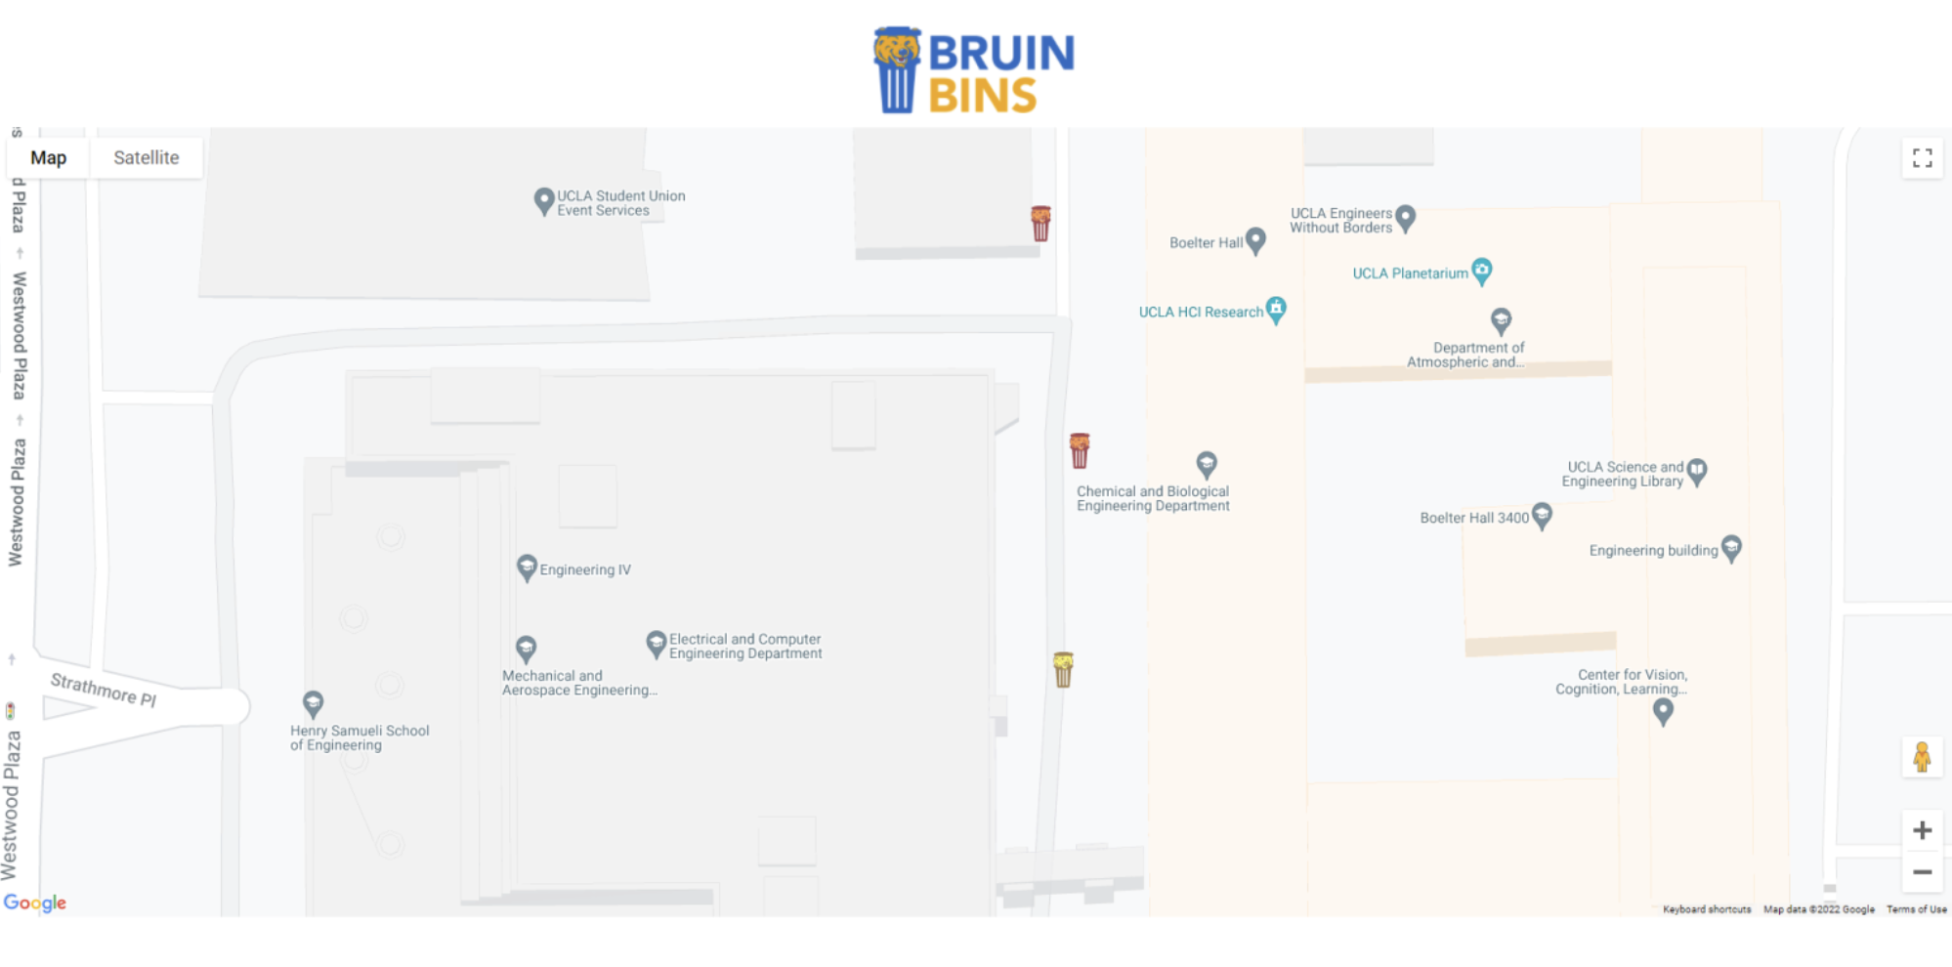
Software feature 1: Map display
Guides students to available trash cans
Full
Full
Half Full

Slide 12
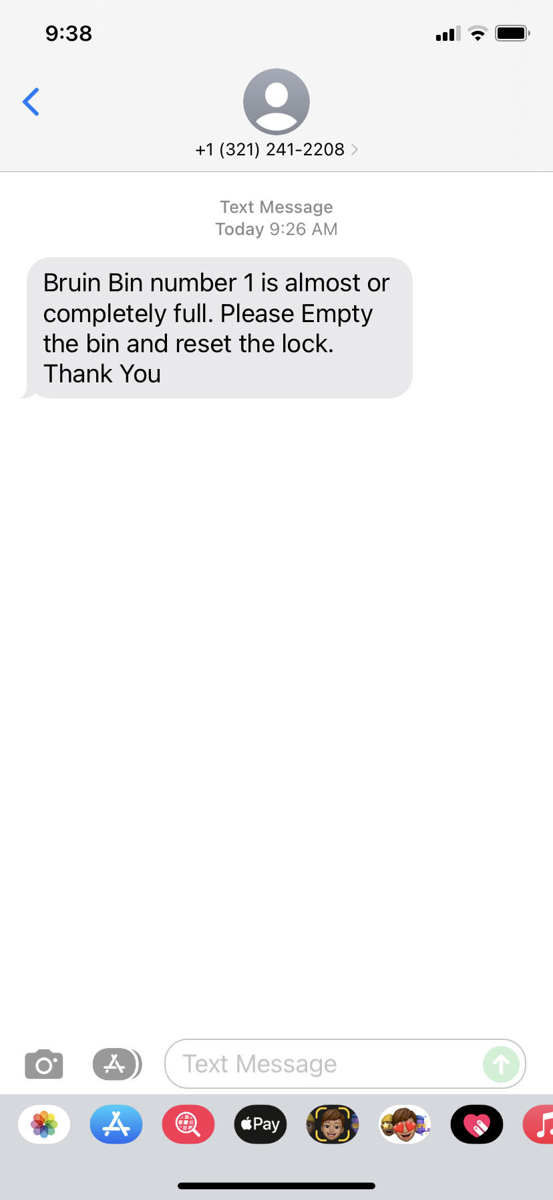
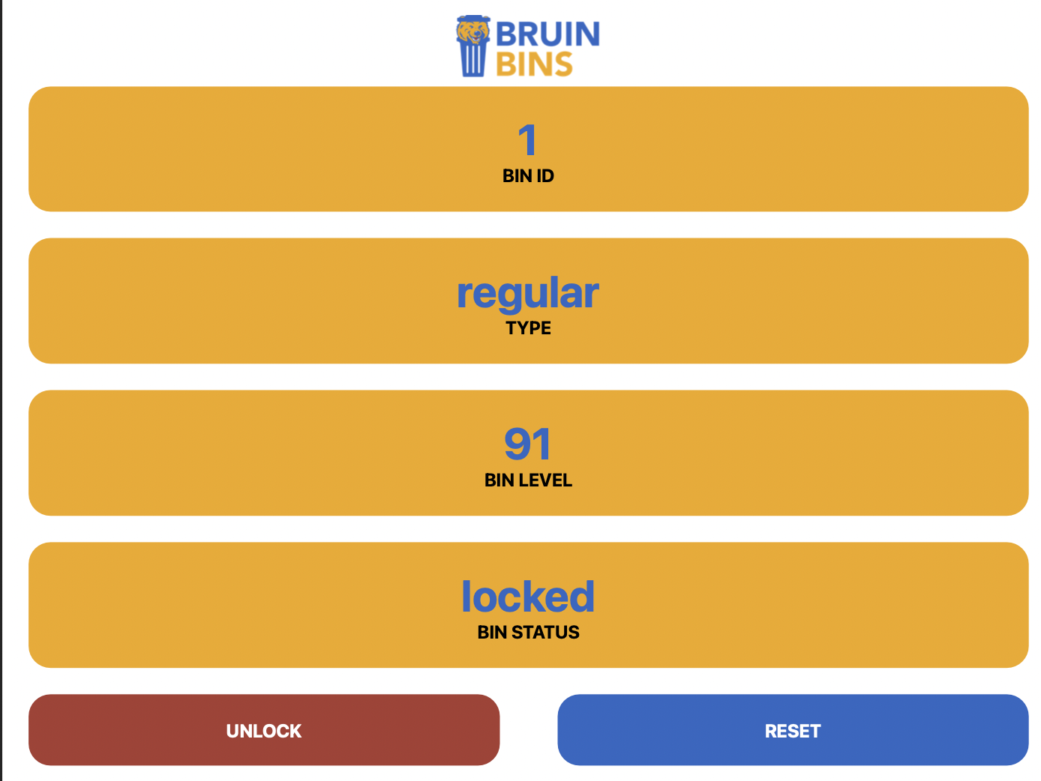
Software feature 2: Admin access
The unique QR code for each trash can let admin unlock the trash can to collect the trash

Slide 13
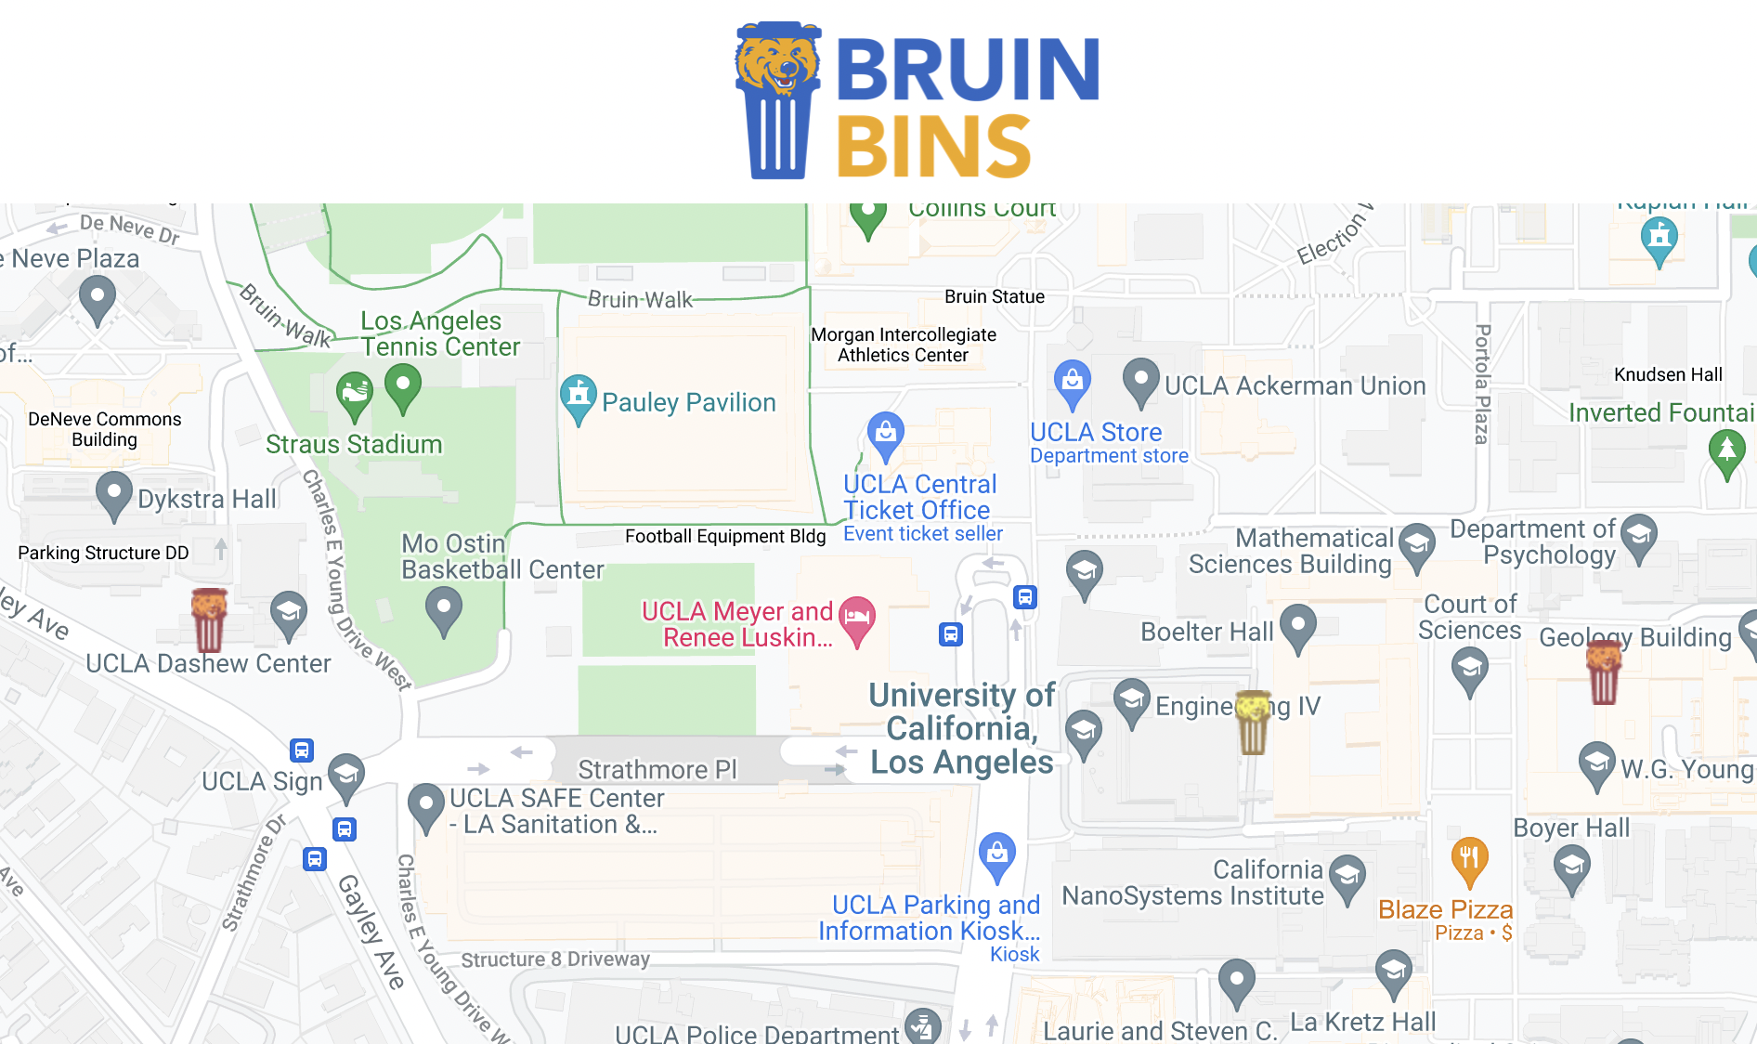
Software feature 3: Data Visualization
Show state of each trash can at any time
Almost full
Full
Empty

Slide 14
Let’s Do a Demo!

Slide 15
Further Applications
Vectors
◂ Onboarding app theme for recycle
◂ Upcycle onboarding app
◂ Recycle onboarding app screens set
Photos
◂ Hazardous waste to nature cans
◂ Set of cartoon glasses and forks

Slide 16
Further Improvements
Location Analysis
Modular Implementation
Improve trash can locations to make trash collection more efficient and economical
Versatile adoption by other schools/organizations increases availability of data.
Waste Statistics
Raise Awareness
Adapt UCLA recycling and waste policies in response to the data collected.
Enhance student participation and cooperation in proper trash disposal and environmental activism.

Slide 17
Thank You For Watching!

Slide 18
Questions?

